Slide 1

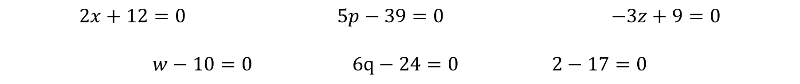
Linear Equations
Linear equations are equations where, after expansion of any brackets and separation of fractions, only terms that are just a number, or the variable multiplied or divided by a number are included.
Linear equations do not involve the variable squared, cubed, square rooted, as a power etc.
$2x+17=5$ $5p−7=32$ $15−3z=6$
$\frac{w}{2}=5$ $2\left(3q−5\right)+1=15$ $\frac{2n+3}{5}=4$
All linear equations can be written in the form $mx+b=0$ with a little bit of rearranging and can therefore be graphed as a straight line.
$2x+12=0$ $5p−39=0$ $−3z+9=0$
$w−10=0$ $6q−24=0$ $2−17=0$

Slide 2
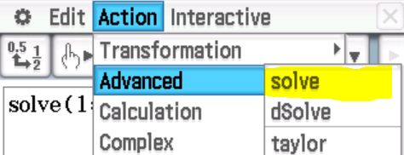











Examples – step by step and using Class Pad
$$x+9=21$$
$$5x−7=23$$
$$15−2x=4$$
-9
-9
+7
+7
-15
-15
$$x=12$$
$$5x=30$$
$$−2x=−11$$
/5
/5
/-2
/-2
$$x=6$$
$$x=5.5$$

Slide 3


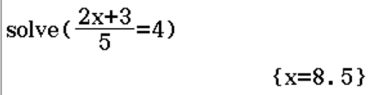










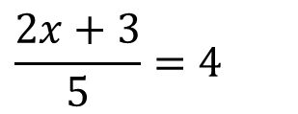

Examples – step by step and using Class Pad
$$3(x−1)=21$$
$$3\left(2x+1\right)−5=40$$
$$\frac{2x+3}{5}=4$$
$$x−1=7$$
+5
$$3\left(2x+1\right)=45$$
+5
x5
$$2x+3=20$$
x5
/3
/3
+1
+1
/3
$$2x+1=15$$
/3
-3
$$2x=17$$
-3
$$x=8$$
-1
$$2x=14$$
-1
/2
$$x=8.5$$
/2
/2
$$x=7$$
/2

Slide 4






Examples – step by step and using Class Pad
$$2\left(x+3\right)−3\left(2x+1\right)=−5$$
$$2x+6−6x−3=−5$$
$$−4x+3=−5$$
-3
-3
$$−4x=−8$$
/-4
/-4
$$x=2$$

Slide 5
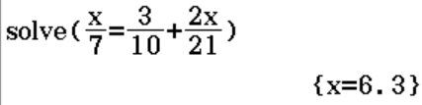
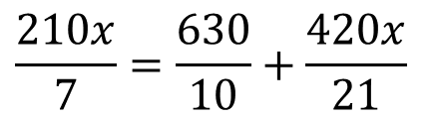
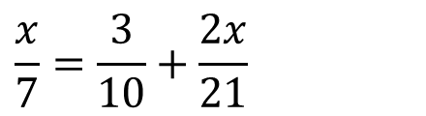



Examples – step by step and using Class Pad
$$\frac{x}{7}=\frac{3}{10}+\frac{2x}{21}$$
x210
x210
$$\frac{210x}{7}=\frac{630}{10}+\frac{420x}{21}$$
$$30x=63+20x$$
-20x
-20x
$$10x=63$$
/10
/10
$$x=6.3$$

Slide 6

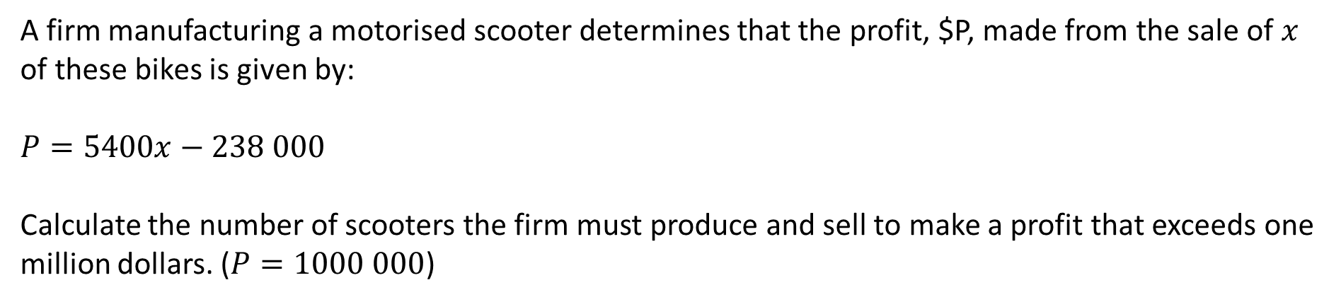


Examples – step by step and using Class Pad
A firm manufacturing a motorised scooter determines that the profit, $P, made from the sale of $x$ of these bikes is given by:
$$P=5400x−238 000$$
Calculate the number of scooters the firm must produce and sell to make a profit that exceeds one million dollars. ($P=1000 000$)
However, the answer needs to be a whole amount of scooters and even though 229.26 rounds down, 229 scooters would not make enough money so we have to round up.
$$5400x−238 000=1000 000$$
+238000
$$5400x=1238 000$$
+238000
/5400
/5400
$$x=229.26$$
The firm needs to make 230 motorised scooters to make a profit of greater than $1000 000

Slide 7
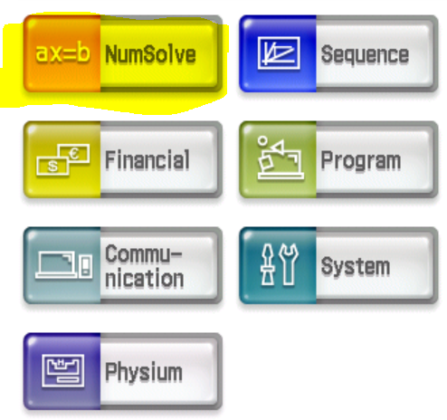
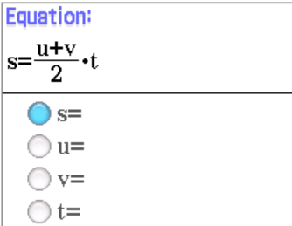
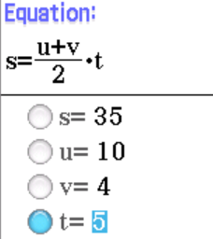
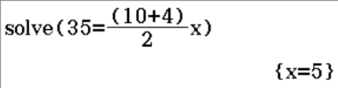


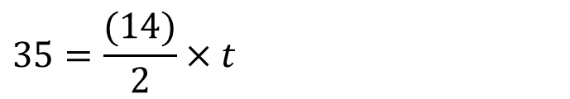
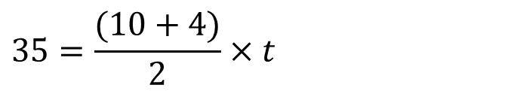
Examples – step by step and using Class Pad
Formula: $s=\frac{(u+v)}{2}t$
Find $t$ given that $s=35, u=10$and $v=4$
Or can use NumSolve on 2nd page of Class Pad menu:
$$35=\frac{(10+4)}{2}×t$$
$$35=\frac{(14)}{2}×t$$
/7
/7
$$35=7t$$
$$t=5$$

Slide 8
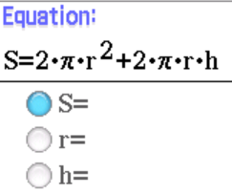
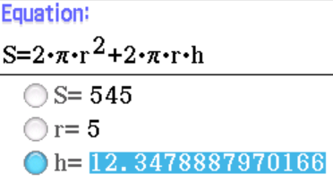

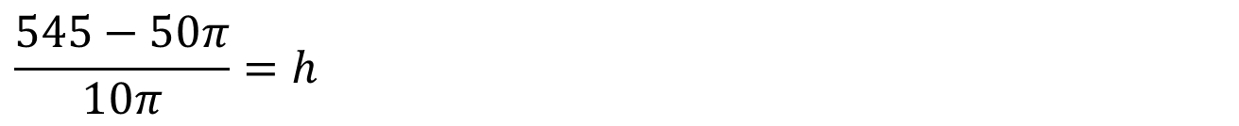
Examples – step by step and using Class Pad
Now do exercise 6
Formula: $S=2πr^{2}+2πrh$
Find $h$ given that $S=545$and $r=5$
$$545=2π{×5}^{2}+ 2π×5×h$$
Or can use NumSolve on 2nd page of Class Pad menu:
$$545=50π+10πh$$
-50∏
-50∏
$$545−50π=10πh$$
/10∏
/10∏
$$\frac{545−50π}{10π}=h$$
$h=12.3$ (to 1dp)

